Slide 1


Department of Computer Science #FSTMKUIS
fstm.kuis.edu.my/blog/php

Slide 2
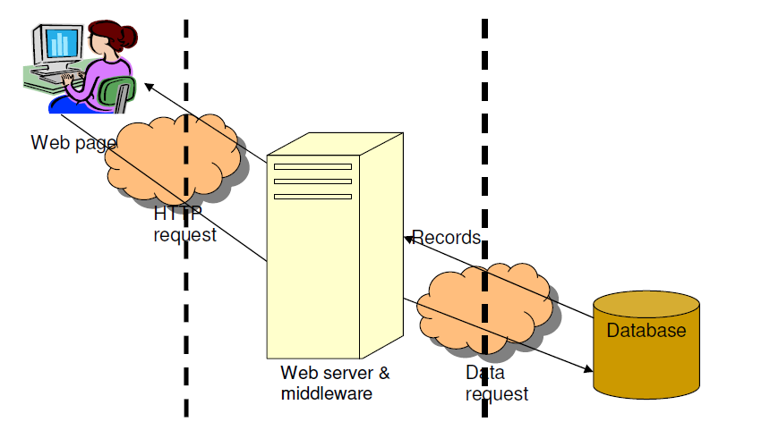
Intro Concept of 3-tier

Slide 3
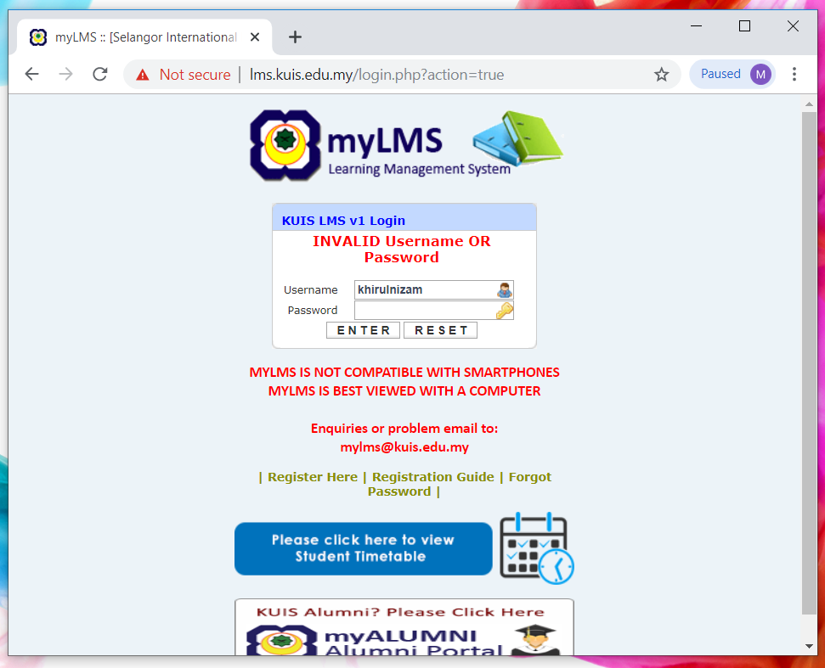
Example LMS

Slide 4
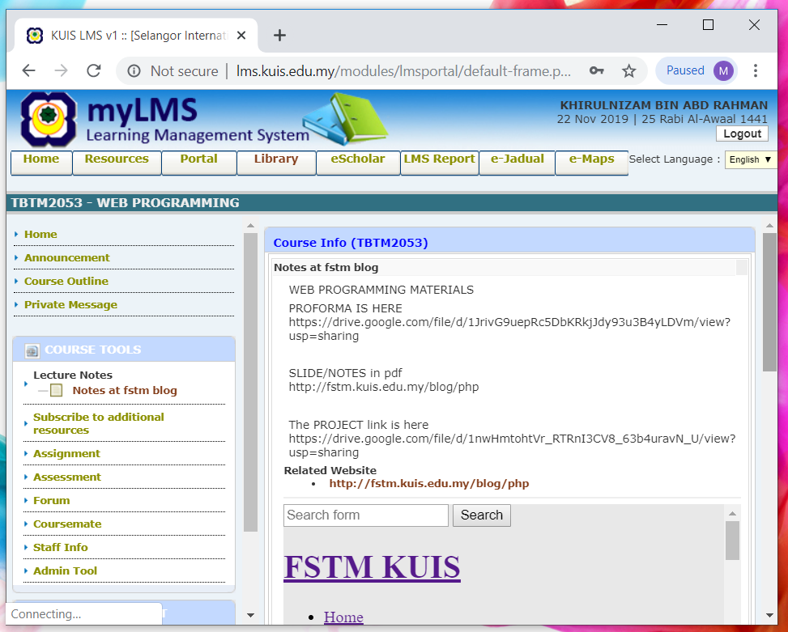

Slide 5

WEB PROGRAMMING
Chapter 0
HTML5 &
Bootstrap
Department of Computer Science #FSTMKUIS
fstm.kuis.edu.my/blog/php

Slide 6


Training outline
HTML5 – refers to the modern day of HTML which promotes native handling of video & audio & animation without having to install additional plugins to browser.
Bootstrap – A HTML framework supports responsive web design to provide one time webpage development for smartphone, tablet and desktop.

Slide 7
HTML5
HTML5 – refers to the modern day of HTML which promotes native handling of video & audio & animation without having to install additional plugins to browser.
<!DOCTYPE html>

Slide 8
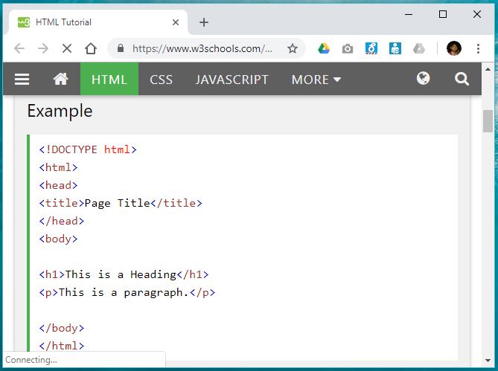
Typical HTML structure

Slide 9
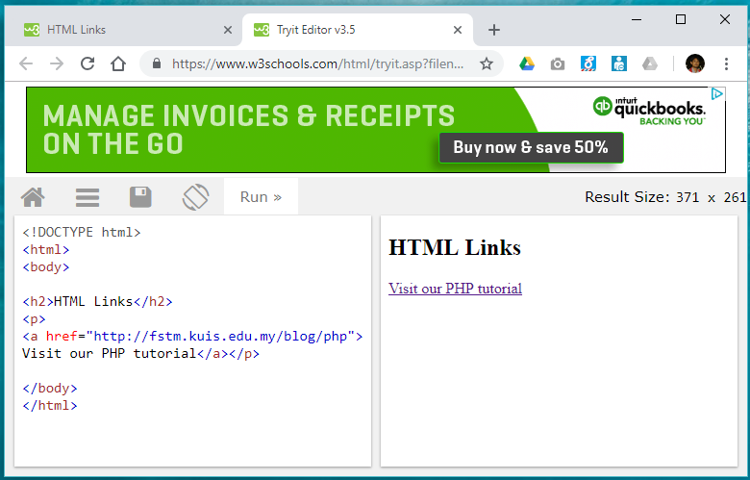
Hyperlink

Slide 10
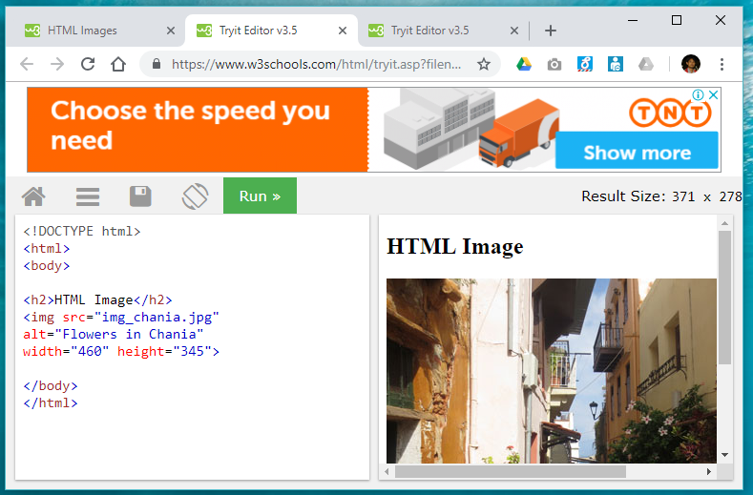
Image

Slide 11
HTML5 image responsive
<img src="pic_mountain.jpg" alt="Mountain View" style="width:304px;height:228px;">
Use width 100% to support responsive layout design.

Slide 12
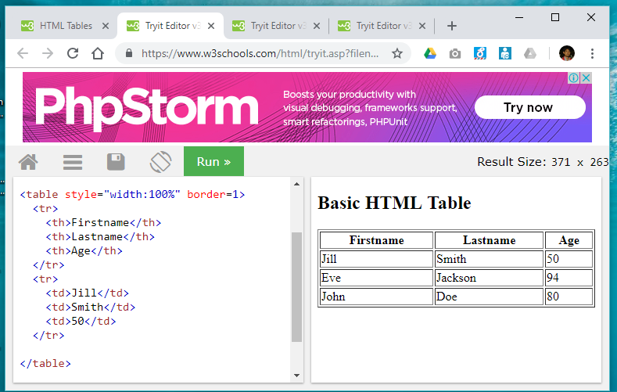
Table

Slide 13
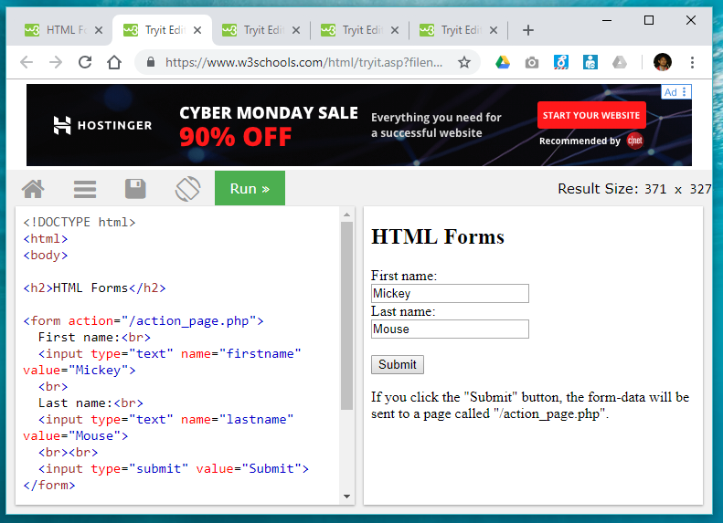
Form

Slide 14
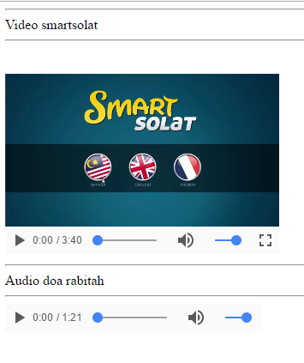
HTML5 Native video
<video width="320" height="240" controls> <source src="movie.mp4" type="video/mp4"> <source src="movie.ogg" type="video/ogg"> Your browser does not support the video tag. </video>

Slide 15
HTML5 Native AUDIO
<audio controls> <source src="horse.ogg" type="audio/ogg"> <source src="horse.mp3" type="audio/mpeg"> Your browser does not support the audio element. </audio>

Slide 16
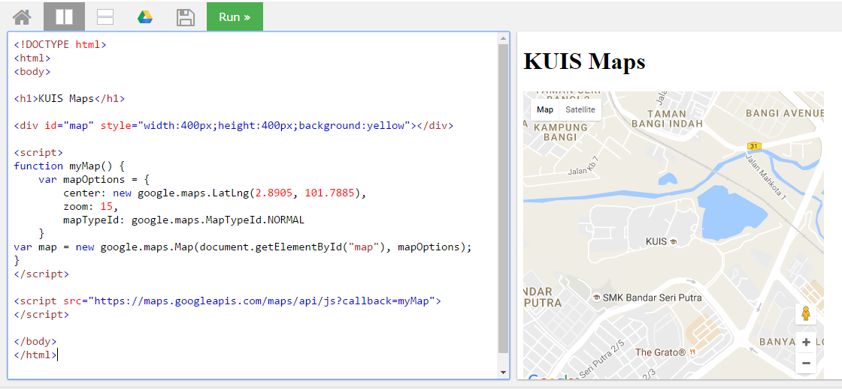
Location MAPS

Slide 17
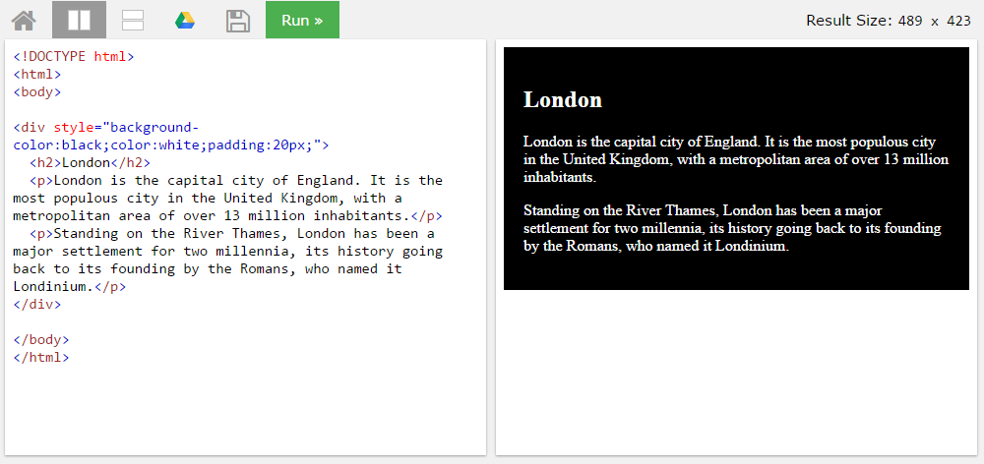
BLOCK <DIV>

Slide 18
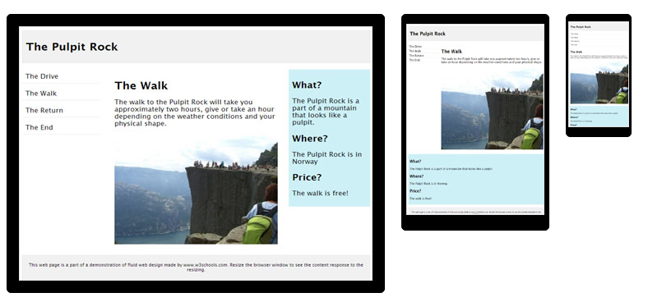
HTML Responsive layout

Slide 19
HTML Responsive layout
What is Responsive Web Design?
Responsive Web Design makes your web page look good on all devices (desktops, tablets, and phones).
Responsive Web Design is about using CSS and HTML to resize, hide, shrink, enlarge, or move the content to make it look good on any screen

Slide 20
VIEWPORT
<meta name="viewport" content="width=device-width, initial-scale=1">
The viewport varies with the device, and will be smaller on a mobile phone than on a computer screen.
The initial-scale=1.0 part sets the initial zoom level when the page is first loaded by the browser.

Slide 21
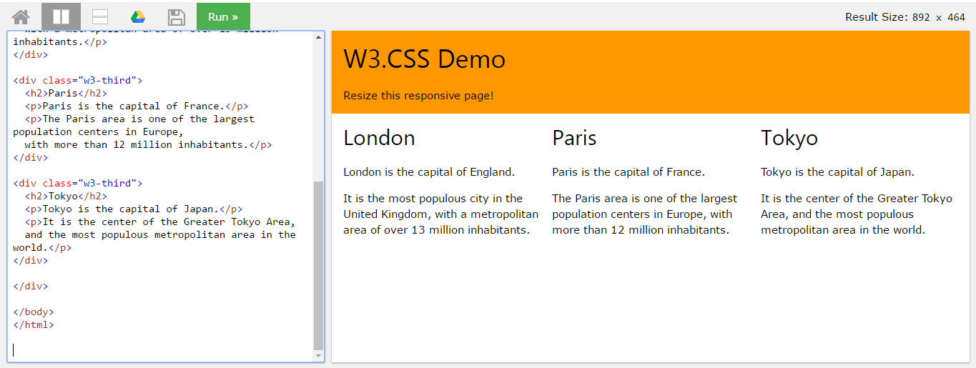
HTML Responsive layout

Slide 22
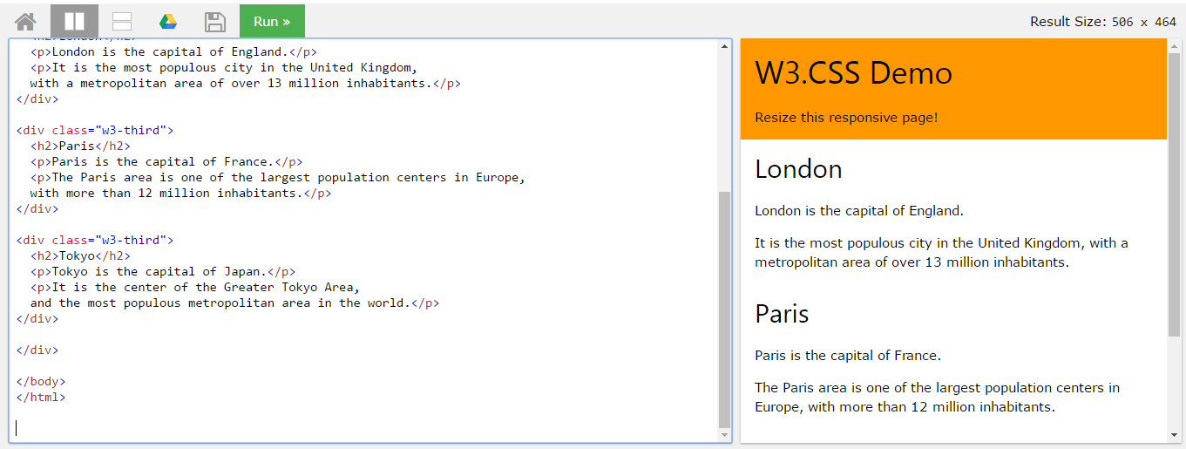
HTML Responsive layout

Slide 23

Bootstrap
A HTML framework supports responsive web design to provide one time webpage development for smartphone, tablet and desktop.

Slide 24
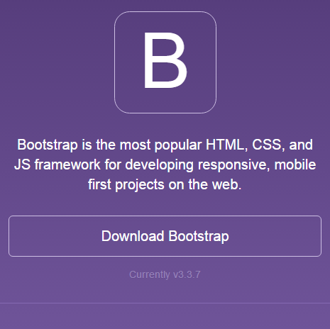
Bootstrap
Download framework from getbootstrap.com
OR use the CDN

Slide 25
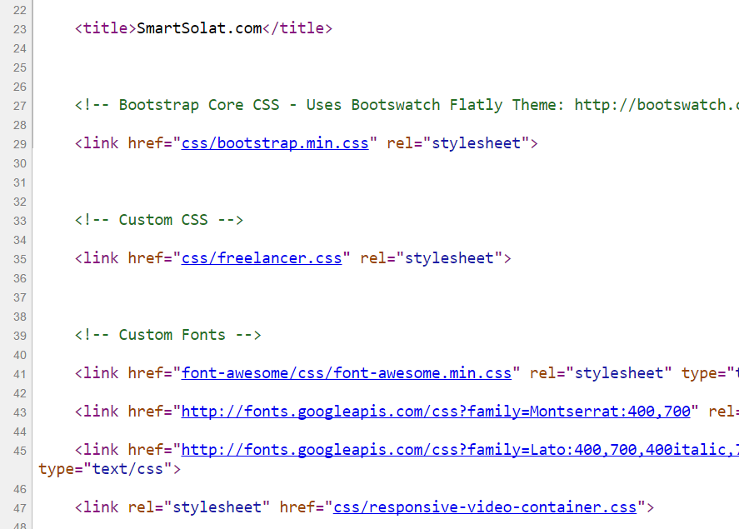
Bootstrap -setting
> Copy the CSS script to the project folder.
> OR we can use CDN server

Slide 26
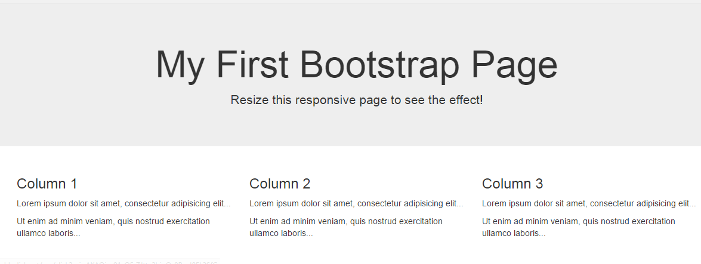
Basic bootstrap layout
Try it here http://www.w3schools.com/bootstrap/tryit.asp?filename=trybs_default&stacked=h

Slide 27
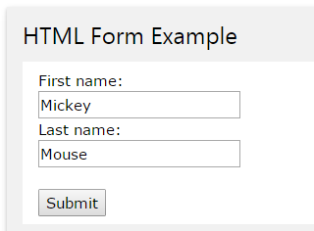
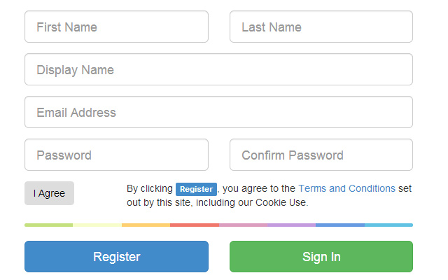
BOOTSTRAP FORM

Slide 28
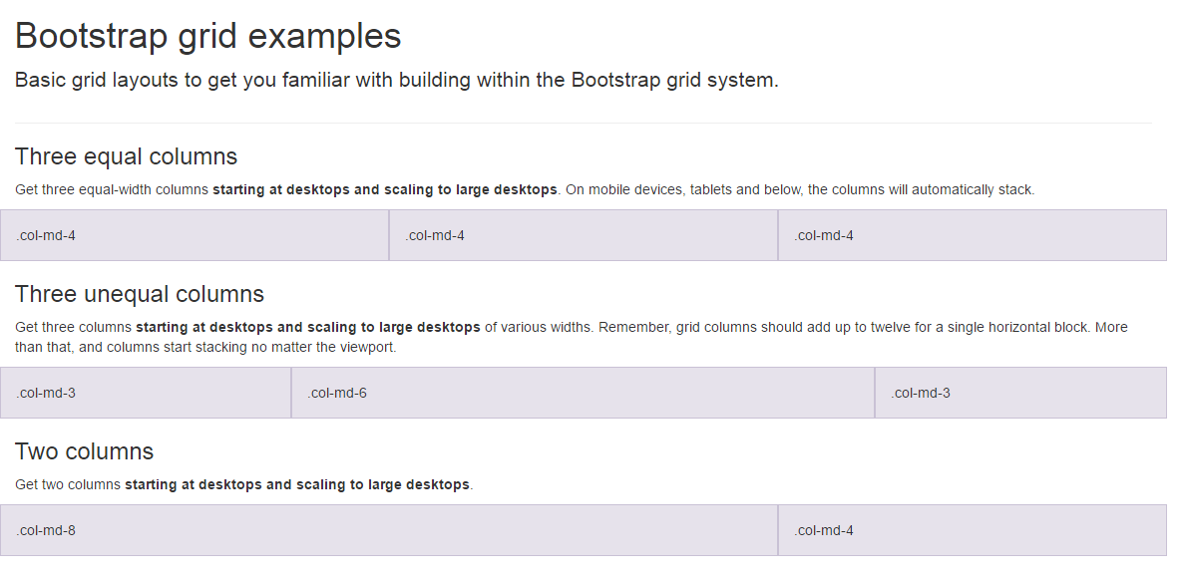
BootSTRAP GRID SYSTEM

Slide 29
BootSTRAP GRID SYSTEM DESKTOP
Banner
Main Content
Sidebar
Footer

Slide 30
BootSTRAP GRID SYSTEM MOBILE
Banner
Main Content
Sidebar
Footer

Slide 31

FREE STARTbootstrap.com
Example https://startbootstrap.com/

Slide 32
WEB PROGRAMMING
Chapter 1
Introduction to PHP
Department of Computer Science #FSTMKUIS
fstm.kuis.edu.my/blog/php

Slide 33

Introduction
What is Web programming:
Combination of server-side and client-side to develop a dynamic website.
The application is deployed in the Web environment and can be access by multiple concurrent users.
In order to start learning PHP, you should have a basic understanding of HTML first.

Slide 34
Introduction to PHP
PHP= PHP: Hypertext Preprocessor:
Is a server-side scripting language.
PHP scripts are executed on the server, and the output from the process is inserted to the Web page as a part of the content before transmitted to the browser.
The script will not be sent to the browser which request the Web page, so the script is not visible to the users.

Slide 35
Introduction to PHP (cont)
PHP is built upon an easy integration of all open source products. The term LAMP is synonym with
PHP= PHP: Hypertext Preprocessor:
PHP is built upon an easy integration of all open source products.
The term LAMP is synonym with Linux, Apache, MySQL & PHP.
Supports many databases (MySQL, Oracle etc.).
Is an open source software.
Is free to download and use.
PHP files have a file extension of .php.

Slide 36
Introduction to PHP(cont)
Server-side Scripting | Client-side scripting
The script embedded inside the HTML page, interpreted and executed inside the server (the web server) and the result/output of the execution is sent to the browser. The script interpreted and executed inside the server. E.g.: PHP, ASP. | The script embedded inside the HTML page, downloaded with the HTML page and executed on the client (browser). E.g.: JavaScript.

Slide 37
Introduction to PHP(cont)
What is MySQL?
Is a database server.
Is ideal for both small and large applications.
Supports standard SQL.
Is free to download and use.

Slide 38
Introduction to PHP(cont)
PHP + MySQL:
PHP combined with MySQL are cross-platform (you can develop in Windows and serve on a Unix platform).

Slide 39
Introduction to PHP(cont)
Why PHP?
Runs on different platforms (Windows, Linux, Unix, etc.).
Is compatible with almost all servers used today (Apache, IIS, etc.).
Is free to download.
Is easy to learn and runs efficiently on the server side.

Slide 40
PHP Development Tools
How to start?
To get access to a Web server with PHP support, you can:
(1) Install Apache as Web server,
(2) Install PHP as the server script interpreter, and
(3) Install MySQL as the database server.
Solution: Install XAMPP.

Slide 41
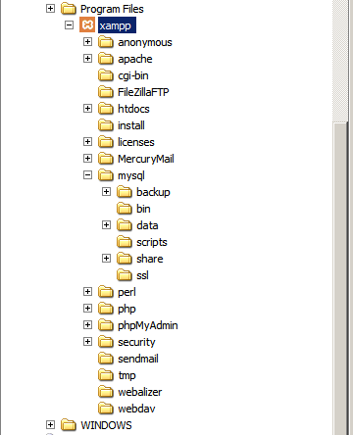
PHP Development Tools (cont)
XAMPP application folder:
htdocs – the Web root where we save all the PHP scripts)
mysql/data – where MySQL store the database records
phpMyAdmin – the Web based MySQL administrator

Slide 42
WEB PROGRAMMING
Chapter 2
PHP Syntax
Department of Computer Science #FSTMKUIS
fstm.kuis.edu.my/blog/php

Slide 43
PHP Script Tag
A PHP scripting block always starts with <?php and ends with ?>.
A PHP scripting block can be placed anywhere in the document.
On servers with shorthand support enabled you can start a scripting block with <? and end with ?>.

Slide 44
PHP Script Tag (cont)
A PHP file normally contains HTML tags, just like an HTML file, and some PHP scripting code.
Next, we have an example of a simple PHP script which sends the text “Assalamualaikum" to the browser:

Slide 45
PHP Script Tag (cont)
<html>
<head>
<title> Web Programming </title>
</head>
<body>
<?php
echo "Assalamualaikum";
?>
</body>
</html>

Slide 46
PHP Script Tag (cont)
Each code line in PHP must end with a semicolon.
The semicolon is a separator and is used to distinguish one set of instructions from another.

Slide 47
PHP Script Tag (cont)
There are two basic statements to output text with PHP: echo and print.
In the example before, we have used the echo statement to output the text "Assalamualaikum".

Slide 48
Comments in PHP
Comment is code that will not be compiled (ignored when the program is compiled).
It will not effect the code.
It is a good practice to write the comment.
Comment is useful the tell others what is the programming doing.
Helps programmer to memorize what is he doing.

Slide 49
Comments in PHP (cont)
In PHP, we use:
// to make a single-line comment or
/* and */ to make a large comment block.

Slide 50
Comments in PHP (cont)
<html>
<head>
<title> Web Programming </title>
</head>
<body>
<?php //This is a comment /* This is a comment block */ ?>
</body>
</html>

Slide 51
PHP Variables
Variables are used for storing values, like text strings, numbers or arrays.
When a variable is declared, it can be used over and over again in your script.
All variables in PHP start with a $ sign symbol.
The correct way of declaring a variable in PHP:
E.g.: $var_name = value;

Slide 52
PHP Variables (cont)
New PHP programmers often forget the $ sign at the beginning of the variable.
In that case it will not work.
Let's try creating a variable containing a string and a variable containing a number:

Slide 53
PHP Variables (cont)
<?php
$txt="Assalamualaikum!";
$x=23;
echo $txt;
?>

Slide 54
Exercise 2.1
Write the echo( )statement to display the following message:
Assalamualaikum!23

Slide 55
Answer 2.1
<?php
$txt="Assalamualaikum!";
$x=23;
echo $txt;
echo $x;
?>

Slide 56
Exercise 2.2
Write the echo( )statement to display the following message:
Assalamualaikum!
23

Slide 57
Answer 2.2
<?php
$txt="Assalamualaikum!";
$x=23;
echo $txt. "<br>";
echo $x;
?>

Slide 58
Exercise 2.3
Write the echo( )statement to display the following message:
My name is Ibtisam.
I am 21 years old.

Slide 59
Answer 2.3
<?php
$name = "Ibtisam";
$age = 21;
echo "My name is $name. <br>";
echo "I am $age years old.";
?>

Slide 60
Exercise 2.4
Write the echo( )statement to display the following message:
Assalamu`alaikum to all!
My name is Ibtisam.
I am 21 years old.

Slide 61
Answer 2.4
<?php
$salam = "Assalamu`alaikum";
$name = "Ibtisam";
$age = 21;
echo "$salam to all! <br>";
echo "My name is $name. <br>";
echo "I am $age years old.";
?>

Slide 62
Exercise 2.5
Detect the error for the following script:
<?php
$nama="Ibtisam"
echo ("My name is $nama.");
?>

Slide 63
Naming Rules for Variables
A variable name must start with a letter or an underscore "_".
A variable name can only contain alpha-numeric characters and underscores (a-z, A-Z, 0-9, and _ ).
A variable name should not contain spaces.
If a variable name is more than one word, it should be separated with an underscore ($my_string), or with capitalization ($myString).

Slide 64
Exercise 2.6
Decide whether the following variables are valid or invalid. Give your reason.
$apa 11) $my_books
$123lekuk 12) $_myFamily
$what-is-the-number 13) $my address
$_uji1 14) $my2numbers
$my name
$For
IF
$float
$variable_to_hold_names_or_matrix_for_students
$hasil*nombor

Slide 65
Lateral Values
Lateral is the exact/actual value.
The value could be number (integer or real), character, string, or Boolean.

Slide 66
Lateral Values (cont)
Integer:
Integer is round number.
For example, 10 is an integer.
E.g.:
$num = 10;
$num = -10;
Use negative sign for negative numbers.

Slide 67
Lateral Values (cont)
Float:
E.g.:
$temp = 21.1225;
$product = 0.0;

Slide 68
Lateral Values (cont)
Characters:
To assign a character value into a char variable, the value must be put inside a open and close single or double quote.
E.g.:
$nama = ‘Nurul’;
$name = “Ibtisam”;

Slide 69
Lateral Values (cont)
Boolean:
There are only two values for Boolean variable: true and false.
E.g.:
$eatalready = true;
$isInteger = false;

Slide 70
Lateral Values (cont)
String:
A group of characters.
Marked with single or double quote.
E.g.:
$stmt = “How are you”;

Slide 71
Concatenation Operator
There is only one string operator in PHP.
The concatenation operator (.) is used to put two string values together.
To concatenate two string variables together, use the concatenation operator:

Slide 72
Concatenation Operator (cont)
<?php $txt1=“Assalamualaikum!"; $txt2=“Have a nice day!";
echo $txt1 . " " . $txt2; ?>

Slide 73
Concatenation Operator (cont)
The simpler way in doing concatenation:
<?php $txt1=“Assalamualaikum!"; $txt2=“Have a nice day!";
echo “$txt1 $txt2”; ?>

Slide 74
Concatenation Operator (cont)
Or, if you want to print the output in a separate line:
<?php $txt1=“Assalamualaikum!"; $txt2=“Have a nice day!";
echo “$txt1 <br> $txt2”; ?>

Slide 75
WEB PROGRAMMING
Chapter 3
Form
Interactions
Department of Computer Science #FSTMKUIS
fstm.kuis.edu.my/blog/php

Slide 76
Input Through HTML
<form name=“aform” method=“GET” action=“save.php”>
input…
</form>
This is the typical structure of form:
name: is the name of the form.
method: how the data is transferred (POST or GET).
action: is the target file resides in the Web server that receive the data from the form.
input: are the input elements (text field, checkbox, radio button, etc.).

Slide 77
GET vs. POST
GET | POST
Is basically for just getting (retrieving) data. The variable name and the value appear and visible in the URL. Form data is to be encoded (by a browser) into at the end of the URL of the target file. | Form data is embedded within a message body. POST may involve anything, like storing files to the server, updating data, ordering a product, or sending an e-mail. The variable name and the value do not appear in the URL.

Slide 78
Example 1 (Using GET Method)

Slide 79
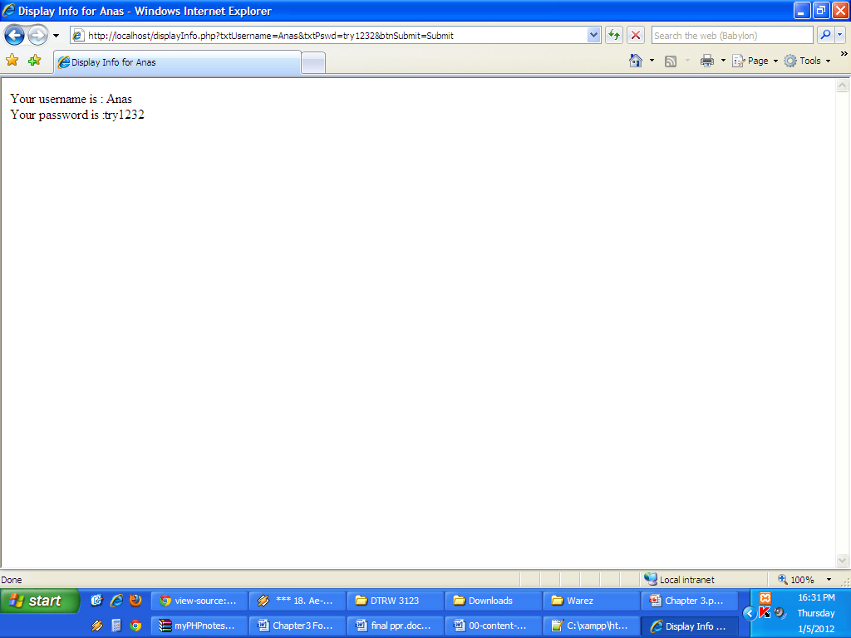
Example 1 (cont)

Slide 80
Example 1 (cont)
Since PHP is a server-side scripting, it is interpreted/executed inside the server.
The output of the script execution is embedded inside the page which contains the script.
At the end of the process, the HTML page, together with the output generated, is sent to the browser (client).
The script will not be included in the HTML page sent to the browser.

Slide 81
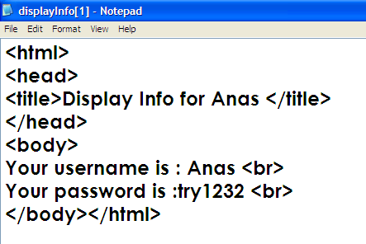
Example 1 (cont)

Slide 82
Example (Using POST Method)

Slide 83
WEB PROGRAMMING
Chapter 4
Operators
Department of Computer Science #FSTMKUIS
fstm.kuis.edu.my/blog/php

Slide 84
Assignment Operators
Assignment Operators | Meaning | Example
Var=expr | Assign the value of expression into the variable. | $num=3; (value 3 is assign the variable num) $a=50; $b=$a; ($b receives the value of $a, which is 50) $sum=($num*3)+10; (value produced on the right expression will be assigned to variable sum)
Var*=expr | Multiplication assignment. | $num*=3; (similar as $num=$num*3;)
Var/=expr | Division assignment. | $num1/=$num2; (similar as $num1=$num1/$num2;)
Var%=expr | Modulus assignment. | $num%=2; (similar as $num=$num%2;)
Var+=expr | Addition assignment. | $sum+=var1; (similar as $sum=$sum+$var1;)
Var -=expr | Subtraction assignment. | $sum=$var1; (similar as $sum=$sum$var1;)

Slide 85
Assignment Operators
Assign means to give value to a variable to be stored.
The symbol is “=”.
Equal to “==” is different from assign “=”.
E.g.:
$num1=3; //value 3 is assigned to the variable $num1

Slide 86
Arithmetic Operators
Operator | Operation | Example
 |  | Mathematical expression | PHP expression
+ | Addition | num1 + 3 | $num1 + 3
- | Subtraction | pi - y | $pi - $y
* | Multiplication | width x height | $width * $height
/ | Division | a/b | $a/$b
% | Modulus | num modulo 3 | $nom%3

Slide 87
Arithmetic Operators (cont)
Operator | Meaning | Example
++ | Unary pre-increment (add 1 to the value in a variable later) | $num++;
 | Unary post-increment (add 1 to the value in a variable) | ++$num;
-- | Unary pre-decrement (subtract 1 from the value in a variable later) | $sum--;
 | Unary post-decrement (subtract 1 from the value in a variable) | --$sum;

Slide 88
Operators Precedence
Operators | Order of evaluation
( ) | First
*, /, % | Second
+, - | Last

Slide 89
Comparison Operators
Operator | Meaning | Example
== | Equal to | ($num == 100)
!= | Not equal to | ($letter != ‘Z’)
< | Less than | ($num1 < $num2)
> | Greater than | ($mark > 80)
<= | Less than or equal to | ($sum <= 10)
>= | Greater than or equal to | ($sum >= $input)

Slide 90
Logical Operators
Operator | Meaning | Example
&& | Logical AND | ($x==1) && ($y==2)
|| | Logical OR | ($huruf==’A’) || ($nom>10)
! | Logical NOT | !( $nombor > 100 )

Slide 91
Example (Add 2 numbers)
Develop a simple Web application to receive two numbers from the user.
The numbers is entered through a HTML form, sent to the server, and another file will receive the number, add both of them and display the result of the operation.

Slide 92
WEB PROGRAMMING
Chapter 5
Array
Department of Computer Science #FSTMKUIS
fstm.kuis.edu.my/blog/php

Slide 93
Introduction of Array
A variable is a storage area holding a number or text. The problem is a variable hold only one value.
An array is a special variable, which can store multiple values in one single variable.

Slide 94
Introduction of Array (cont)
If you have a list of items (a list of student names, for e.g.), storing the student names in single variables could look like this:
$std1=“Anas”; $std2=“Hajar”; $std3=“Shah”;

Slide 95
Introduction of Array (cont)
However, what if you want to loop through the student names and find a specific one? And what if you had not 3 names, but 300?
The best solution here is to use an array!
An array can hold all your variable values under a single name. And you can access the values by referring to the array name.
Each element in the array has its own index so that it can be easily accessed.

Slide 96
Introduction of Array (cont)
In PHP, there are 3 kind of arrays:
Numeric array - An array with a numeric index.
Assign using AUTOMATIC method.
Asign using MANUAL method.
Associative array - An array where each ID key is associated with a value.
Multidimensional array - An array containing one or more arrays.

Slide 97
Numeric Array
Assign using AUTOMATIC method (the index starts at 0).
$std = array(“Anas",“Hajar",“Shah",“Nurul");
Assign using MANUAL method.
$std[0]=“Anas"; $std[1]=“Hajar"; $std[2]=“Shah"; $std[3]=“Nurul";

Slide 98
Example 1
<?php
$std[0]="Anas";
$std[1]="Hajar";
$std[2]="Shah";
$std[3]="Nurul";
echo $std[0] . " and " . $std[1] . " are the students of FSTM.";
?>

Slide 99
Print array
$array = array("Jonathan","Sampson"); foreach($array as $value) { print $value; }

Slide 100
Array Functions
There are a lot of array functions. One of them is array_pop().
The array_pop()function deletes the last element of an array.
E.g.:
<?php
$faculty=array("FSTM","AI","FPM");
$delete=array_pop($faculty);
echo $delete;
?>

Slide 101
Associative Array
$rekod[‘name’]=“Kerul”;
$rekod[‘age’]=27;
$rekod[‘height’]=1.7

Slide 102
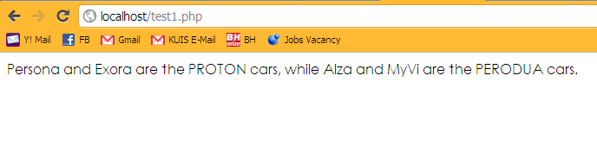
Lab Exercise

Slide 103
WEB PROGRAMMING
Chapter 6
Repetition
Department of Computer Science #FSTMKUIS
fstm.kuis.edu.my/blog/php

Slide 104
Repetition in PHP
There are many ways of doing repetition. Three of them:
for
while and do…while
foreach

Slide 105
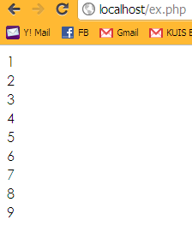
for structure
E.g.:
<?php
for ($i=1;$i<=9;$i++){
echo "$i<br>";
}
?>

Slide 106
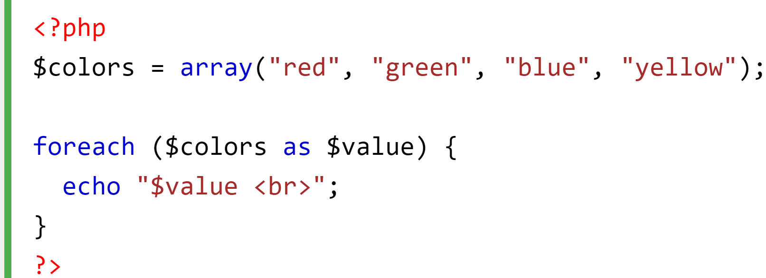
foreach structure
E.g.:

Slide 107
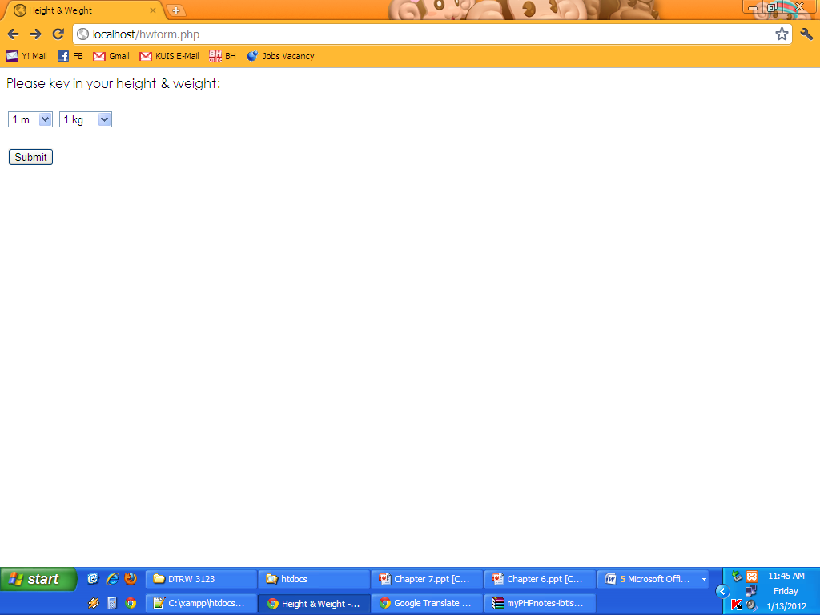
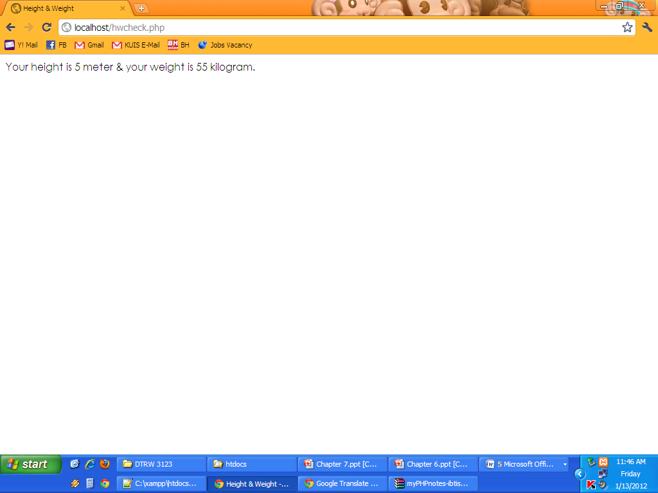
for structure (cont)
Example 1

Slide 108
WEB PROGRAMMING
Chapter 7
Selection
Department of Computer Science #FSTMKUIS
fstm.kuis.edu.my/blog/php

Slide 109
Selection in PHP
if is a PHP reserved words to perform selection:
Simple if: for one choice selection
if…else: for two choices selection
if…else if…else if…else: for handling more than two choices selection
if…else nested: another if statements inside if statement

Slide 110
Simple if
E.g.:
if ($grade == ‘A’)
echo “You are great!”;

Slide 111
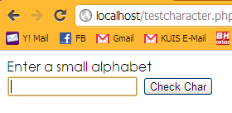
if…else
Example 1

Slide 112
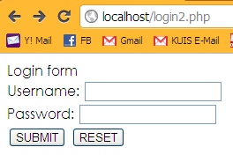
if…else if…else if…else
Example 2

Slide 113
WEB PROGRAMMING
Other PHP
Functions
Department of Computer Science #FSTMKUIS
fstm.kuis.edu.my/blog/php

Slide 114
strpos() function
The strpos() function returns the position of the first occurrence of a string inside another string (start with 0).
If the string is not found, this function returns FALSE.

Slide 115

strpos() function (cont)
E.g.:
<?php
$str = "For the unity of Ummah";
$pos = strpos ($str, "y");
echo $pos;
?>
OR
<?php
echo strpos ("For the unity of Ummah", "y");
?>
0
12

Slide 116
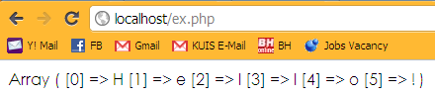
str_split() function
The str_split() function splits a string into an array.
E.g.:
<?php
print_r(str_split("Hello!"));
?>
is used to return an array in a human readable form

Slide 117

substr() function
The substr() returns a part of a string.
Syntax:
substr(string,start,length)
E.g.:
<?php
$string = substr("assalamualaikum", 8, -2);
print $string;
?>
0
8

Slide 118
move_uploaded_file function
The move_uploaded_file() function moves an uploaded file to a new location.
This function returns TRUE on success, or FALSE on failure.
Syntax:
move_uploaded_file(file,newloc)
file: Specifies the file name.
newloc: Specifies the new location (destination) for the file.

Slide 119

<?php OOP ?>

Slide 120
Define OOP
Object Oriented Programming

Slide 121
PHP OOP (Laravel approach)
Class
Method/function
Object
Constructor
Key – value operator in double Array
Associative array

Slide 122
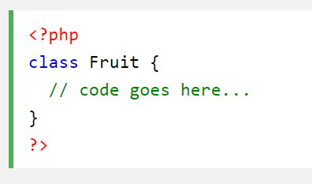
PHP Class

Slide 123
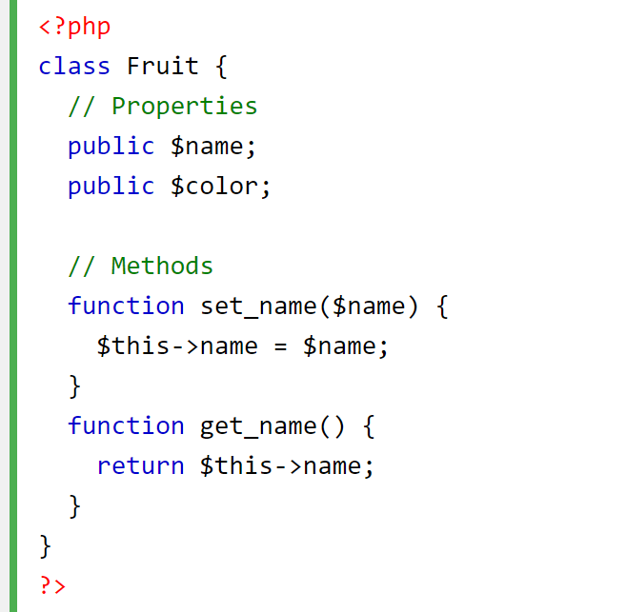
PHP Class with Method

Slide 124
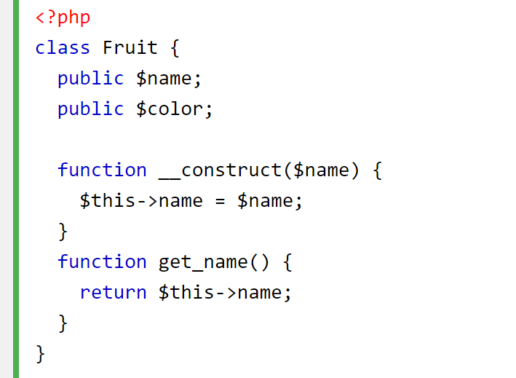
PHP Class with Constructor

Slide 125
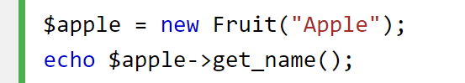
PHP Object Call

Slide 126
{{ laravel blade }}

Slide 127
Laravel blade Scripts
{{ }}
Komen
@if … @endif
@for … @endfor
@foreach … @endforeach
@yield()
@section() … @endsection

Slide 128
WEB PROGRAMMING
Chapter 8
PHP &
Database
Department of Computer Science #FSTMKUIS
fstm.kuis.edu.my/blog/php

Slide 129
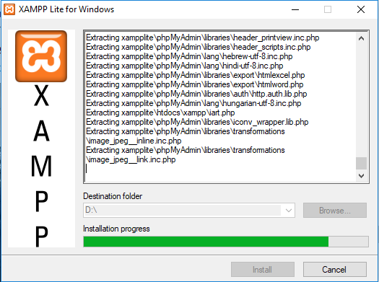
Install xampplite in D:

Slide 130
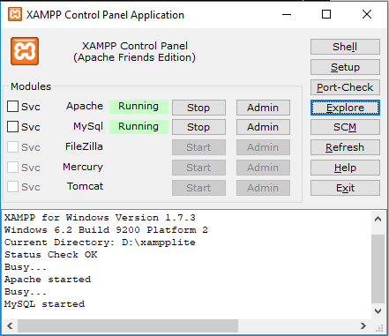
START Apache & MySQL

Slide 131
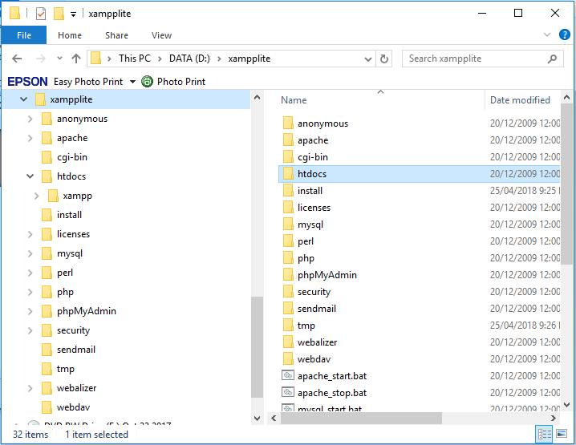
Locate htdocs

Slide 132
MySQL
MySQL is the most popular open-source database system.
MySQL is a database.
The data in MySQL is stored in database objects called tables.
A table is a collection of related data entries and it consists of columns and rows.

Slide 133
MySQL (cont)
A query is a question or a request.
With MySQL, we can query a database for specific information and have a recordset returned.

Slide 134
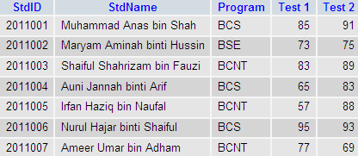
MySQL (cont)
E.g.:
Table 1: StudentMark Table
SELECT StdName
FROM StudentMark;

Slide 135
Connect to a Database
Before you can access data in a database, you must create a connection to the database.
In PHP, this is done with the mysqli_connect() function.
Syntax:
mysqli_connect(servername, username,password);
E.g.: mysql_connect(“localhost”, “root”, “try123”);

Slide 136
Create a Database
The CREATE DATABASE statement is used to create a database in MySQL.
Syntax:
CREATE DATABASE database_name
To get PHP to execute the statement above we must use the mysqli_query() function.
This function is used to send a query or command to a MySQL connection.

Slide 137
Create a Database (cont)
<?php
$db = mysql_connect("localhost","root","");
if (!$db)
{
die('Could not connect: ' . mysql_error());
}
if (mysql_query("CREATE DATABASE my_test_db",$db))
{
echo "Database created";
}
else
{
echo "Error creating database: " . mysql_error();
}
mysql_close($db);
?>

Slide 138

Create a Database (cont)
The previous example creates a database called my_test_db.

Slide 139
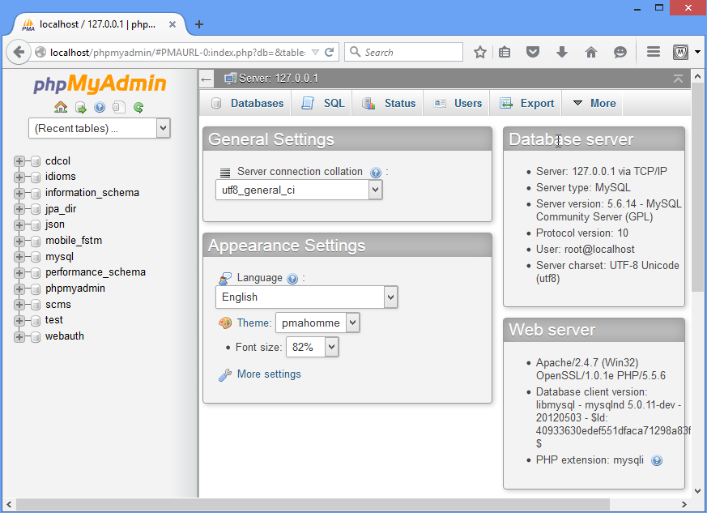
localhost/phpMyAdmin
Or use phpMyAdmin to administer MySQL database

